Slide 1
Team 4 - Payroll
By Jake Watkins-Brown, Matthew Wisden, Pawel Kaczmarczyk, Owain Mahoney

Slide 2
Roles
Matt – To create and update GANTT chart, LSEPI, Quality Assurance documentation. Research and create Vulnerabilities documents.
Owain – Lead Programmer
Pawel -Test and give feedback of the program.
Jake - Update Trello, log members, documenting applications used in the project

Slide 3
Resources used
We used these applications and documents to track our progress and to communicate:
Trello – To track our tasks/Logging our members
Slack – To communicate via text
Messenger – To communicate via voice chat
GitHub – To share program files
GANTT Chart – To show our project timeline
Vulnerability research was used to get a better understanding of the vulnerabilities associated with the program
Postgres was used to store people's information on a database

Slide 4
Phase 1
Phase 1 of the project was to work out what roles our team members had within the project and to decide the approach we wanted to take with the project.
We designed the template/story board for the program to follow as shown previously in the phase 1 seminar.
Between phase 1 and 2 we have decided to change from Python to C# because we feel that C# allows us more flexibility to do what we need the program to do.

Slide 5
Phase 2
We started to create the payroll program and we also researched the vulnerabilities related to our program.
We have decided to implement protections against SQL injection and incorrect authentication because the program may be more vulnerable to those types of security risks compared to other researched vulnerabilities.

Slide 6
Issue Tracking and Quality Assurance
We have been able to track issues in our portfolios.
The most impactful issues throughout our project are:
One team member had a personal issue where they were unable to attend meetings for multiple weeks in Phase 1.
One team member had a baby during phase 1 which reduced their free time exponentially.
Switching programming languages between Phase 1 and 2
Corona virus has put a delay on our project through phase 3
Throughout the project we have been adhering to our quality assurance document to make sure our project is set at a minimum standard.

Slide 7
Vulnerabilities
We reviewed vulnerabilities such as SQL injection, Data leaks, viruses and many more. This helped us understand what they are and how could we avoid these issues within our program.
Data leaks is the most important vulnerability to cover as our program stores people's personal information and earnings.

Slide 8
Program
The following slides will show what our program currently looks like.
Please note that the program is not completed.

Slide 9
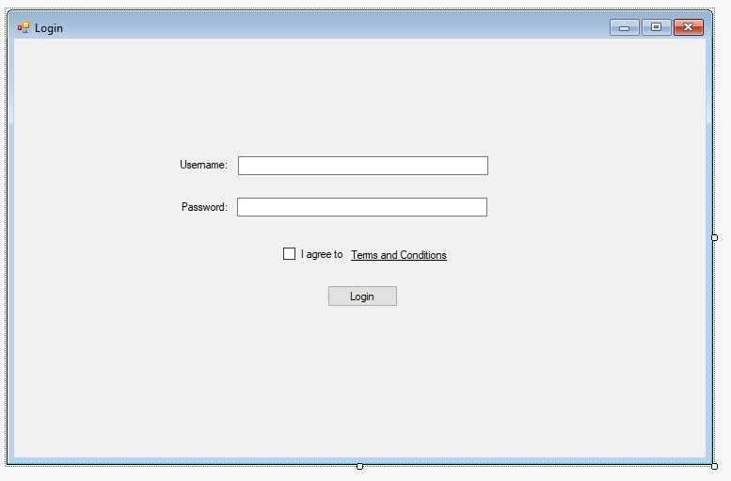
Program

Slide 10
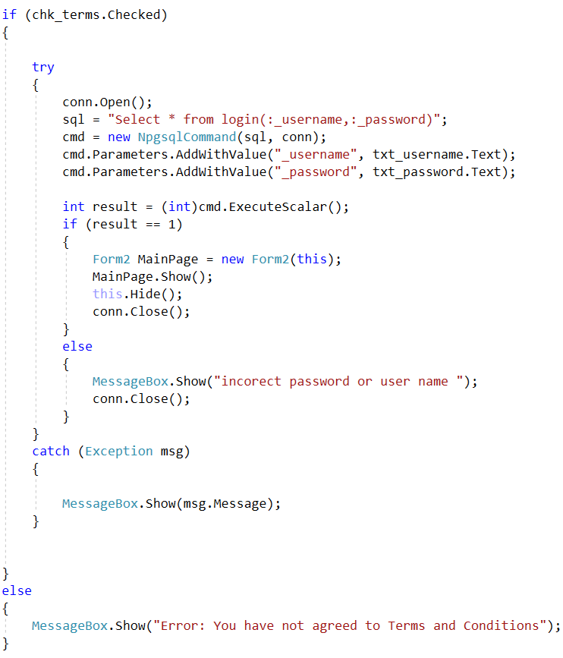
Program
First, we check if terms and conditions have checked if not message box comes up explaining that it needs check it to continue
Then the username and password are added to the query function.
The function run on PostGIS then executed, and the returning scalar value is casted to an integer.
This value is then checked if it equals to 1, which then log the user in.

Slide 11
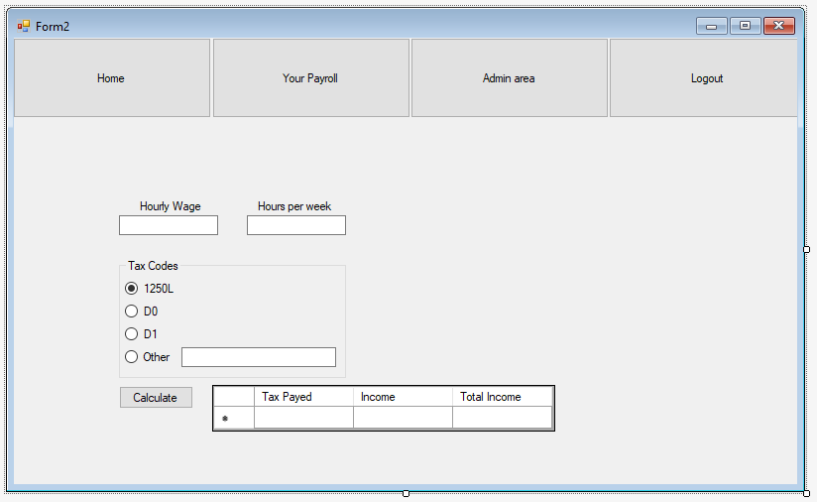
Program

Slide 12
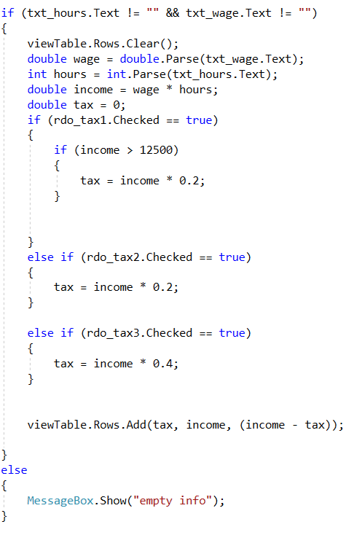
Program
We have decided that we would have three base tax codes.
We have also included an 'other' option however this has yet to be fully implemented.
The tax is calculated based on the tax code selected which is then multiplied by the percentage of tax.
The tax, gross income and actual income is then displayed in a table.

Slide 13
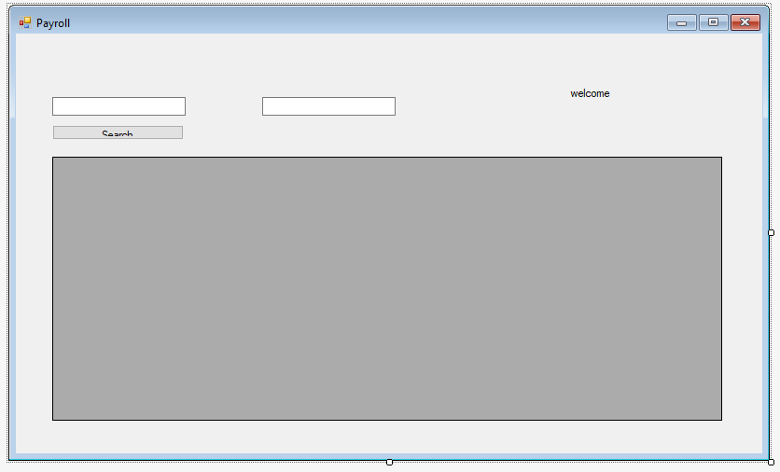
Program

Slide 14
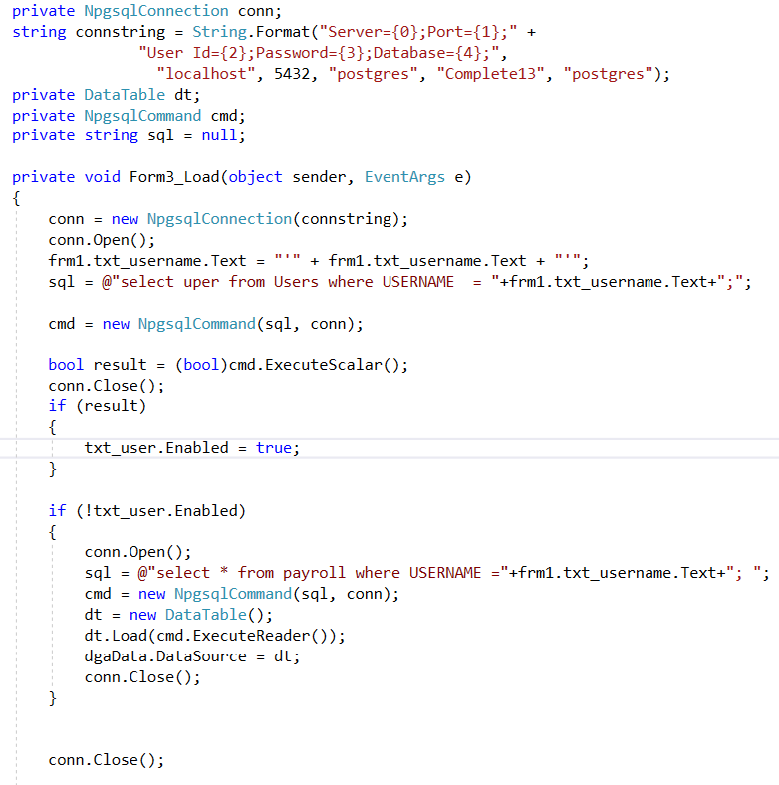
Program
At first a query is used to find the permissions of the user. If the user is a admin they get access to the search engine of the payroll i.e. Search bar becomes enabled
If not admin the payroll of the User only will automatically displayed, and no other functionality is available.

Slide 15
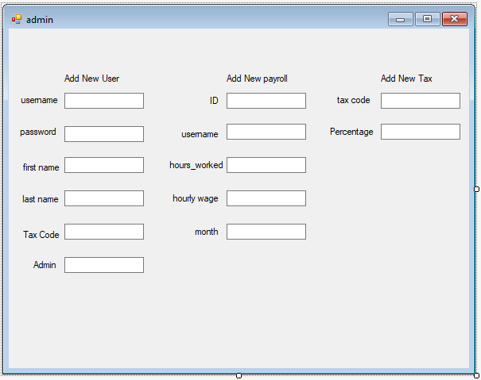
Program
This page is still work in progress and has not yet been coded.

Slide 16
Program Testing
For testing we used an agile technique called extreme programming where two people work on a team as one programs and other tests nearly simultaneously
For the is project lead programmer Owain would program and head of testing Pawel would test the previous version and give feedback on the program.

Slide 17
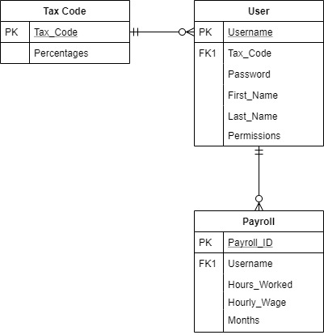
PG Admin/ SQL
The ERD shows how we retrieve data from the database and how we use the data on our program i.e. All user's payroll from certain information.
The database software we chose to use was pgAdmin as it had the best access for the project and if needed could be accessed from anywhere with proper implementation .

Slide 18
Project Observations
During our project we were able to develop many skills such as team working and project building. We were also able to learn how to use GitHub effectively.
We were also able to overcome many obstacles during our project runtime. Especially during phase 1 where many difficult obstacles occurred. However, during phase 2 we had a few minor problems but nothing major compared to phase 1 and that showed in our teamwork capabilities and work overall for that phase.

Slide 19

That's all folks

